Slide 1
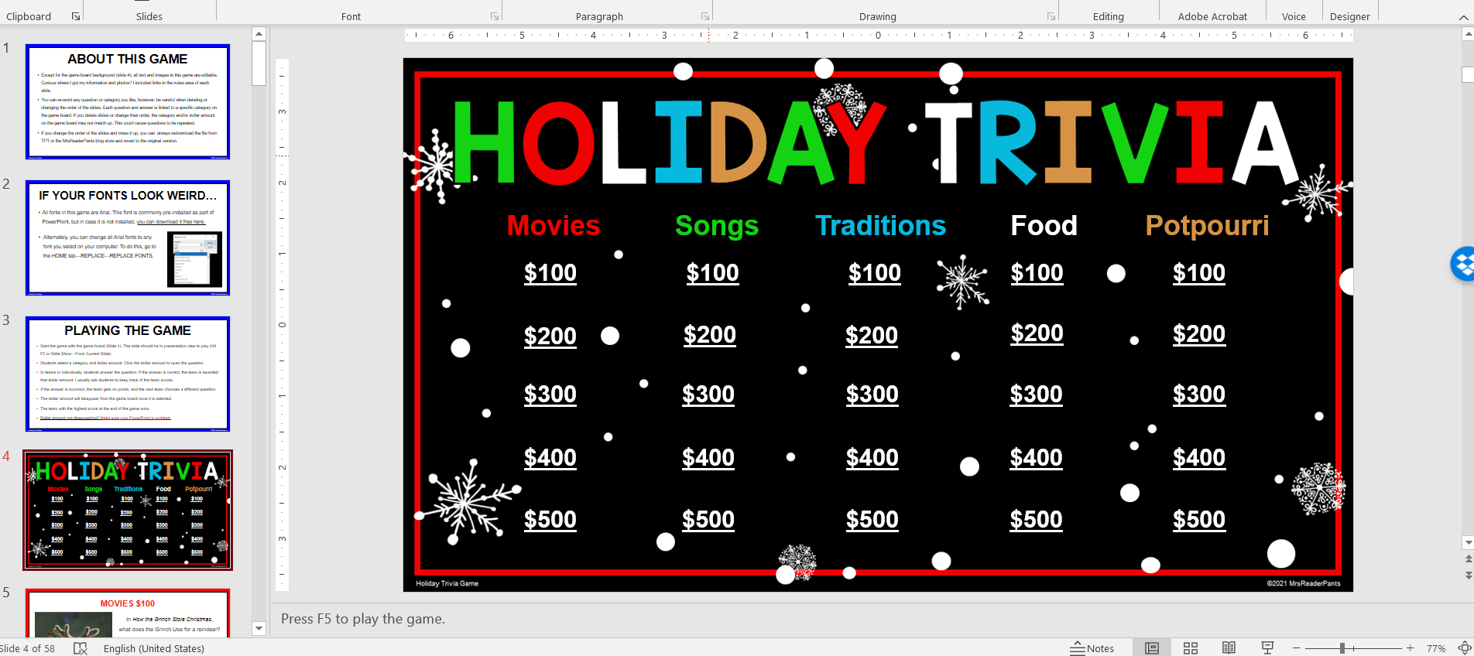
TEST IT OUT!
1
Enable editing in
PowerPoint if it asks you to. It’s the yellow bar that appears when you first open the file.
If it does not show up,
then skip this step.
Play in full-screen mode by clicking here.
Now, hit ENTER to go to game board.
2

Slide 2
Movies | Songs | Traditions | Food | Potpourri
$100
$200
4
When you return to the game board, the dollar amounts should disappear. If they do not disappear, try running a PowerPoint update. Older versions of PPT do not support the features needed in this game.
$300
$300
3
Click a dollar amount to navigate. Do NOT hit ENTER or the arrow keys at any time in the game.

Slide 3
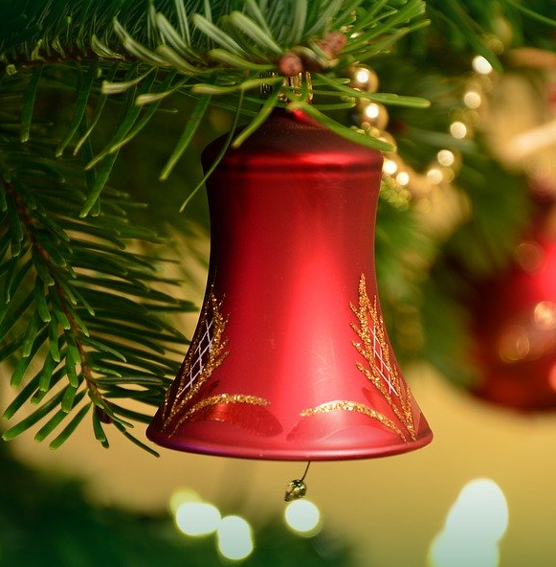
MOVIES $300
According to the 1946 movie It’s a Wonderful Life,
what happens every time a bell rings?
Someone falls in love
An angel gets his wings
A child is born
A mockingbird sings
Click ANSWER.
5
Notes:
Photo by Peggychoucair on Pixabay: https://pixabay.com/photos/christmas-picture-3877444/

Slide 4
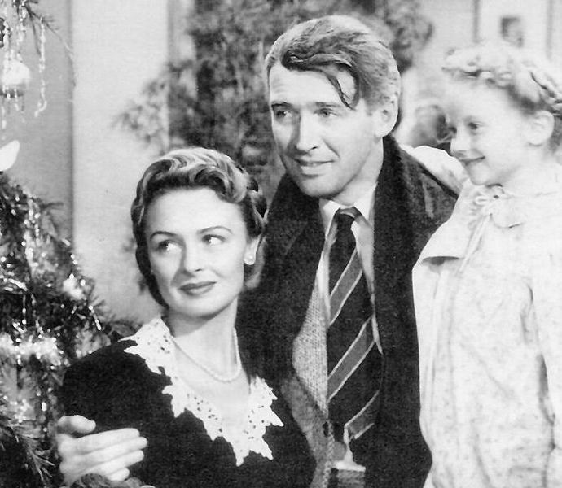
MOVIES $300
B. An angel gets his wings
In the movie, the main character George Bailey learns what the world would be like if he had never been born.
6
Pick one.
Notes:
Photo by National Telefilm Associates - Screenshot of the movie, Public Domain, https://commons.wikimedia.org/w/index.php?curid=6397263

Slide 5
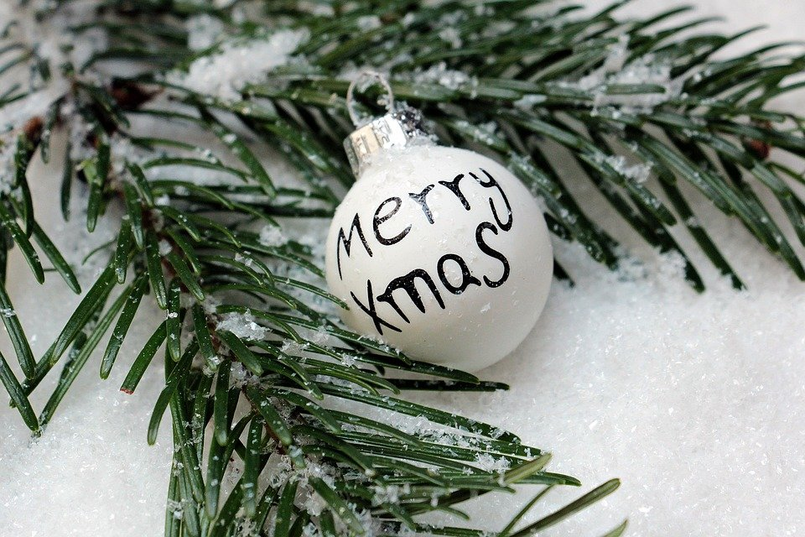
SONGS $200
In “We Wish You a Merry Christmas,” the singer demands to be brought some figgy pudding. What is the main ingredient in figgy pudding?
Fish
Potatoes
Plums or figs
Apples or pears
Click ANSWER.
5
Notes:
Photo by Pixel2013 on Pixabay: https://pixabay.com/photos/christmas-balls-christmas-ornament-1797858/

Slide 6
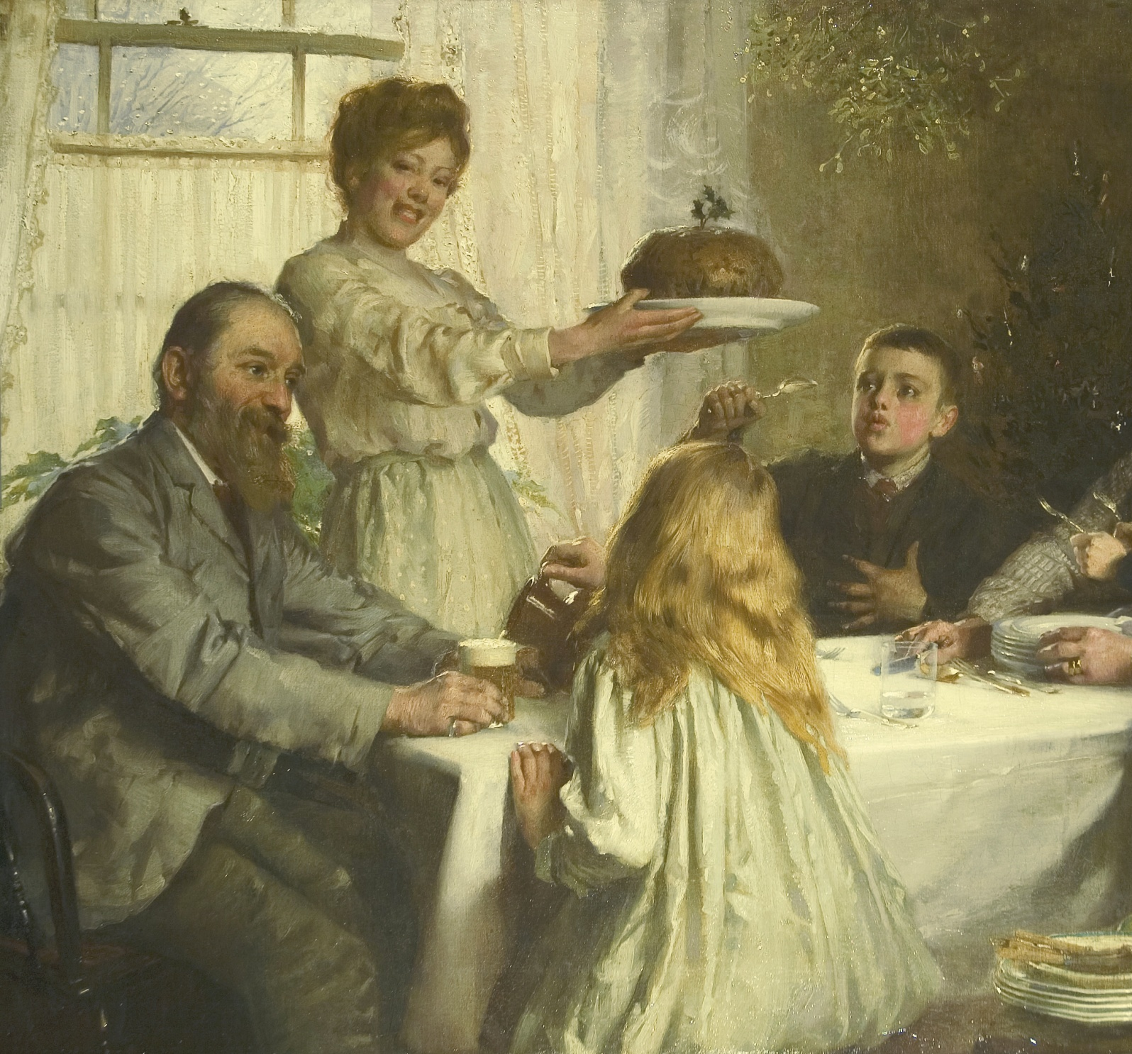
SONGS $200
C. Plums or figs
Traditionally, figgy pudding
—also called Christmas pudding—
must be made about a month
before Christmas so all the
flavors can meld properly.
6
Pick one.
Notes:
Source: https://www.smithsonianmag.com/smart-news/brief-history-figgy-pudding-180957600/
Photo by James Clark - Sotheby's, Public Domain, https://commons.wikimedia.org/w/index.php?curid=65027160

Slide 7
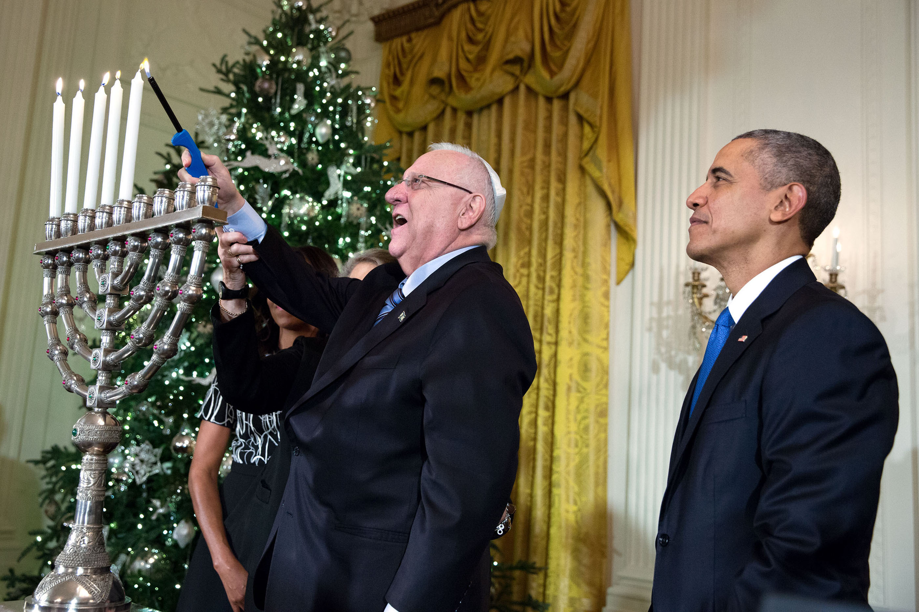
TRADITIONS $300
For how many days is Hanukkah celebrated each year?
A. 7 B. 8 C. 9 D. 10
Click ANSWER.
5
Notes:
Photo by Amanda Lucidon in the White House Archives: https://obamawhitehouse.archives.gov/blog/2015/12/15/hanukkah-white-house-2015-%E2%80%93-memories-menorahs-and-maccabeats

Slide 8
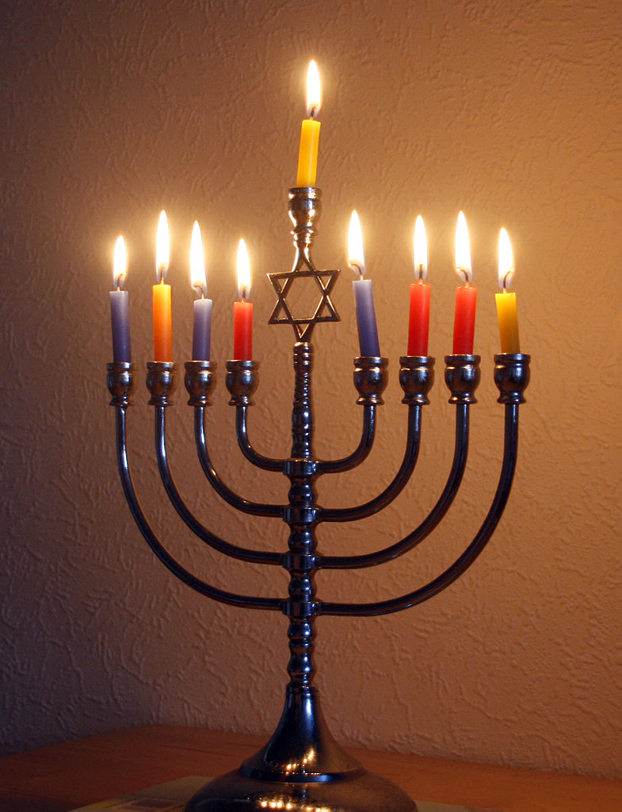
TRADITIONS $300
B. 8 days
For each day during Hanukkah, people light one candle on the menorah. A blessing is offered when the candles are lit each night. The candle in the middle is used to light the other candles.
6
Pick one.
Notes:
Source: https://www.britannica.com/topic/yahrzeit
Photo by 39james - Own work, CC BY-SA 4.0, https://commons.wikimedia.org/w/index.php?curid=37527783

Slide 9
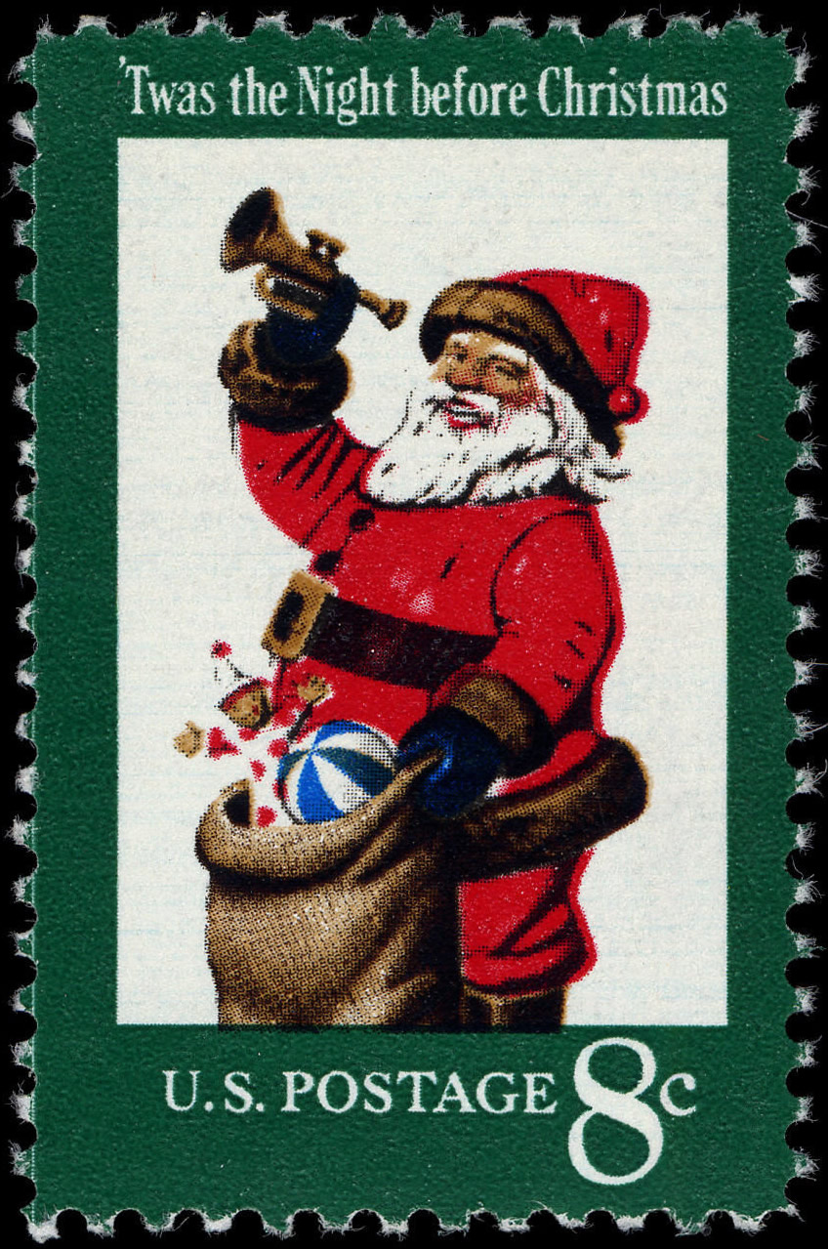
POTPOURRI $100
'Twas the night before Christmas,
When all through the house
Not a creature was stirring,
Not even a ___________
?
Click ANSWER.
5
Notes:
Photo by Bureau of Engraving and Printing. Designed by Stevan Dohanos. - U.S. Postal Service; National Postal Museum: 1972 Christmas Issue, Public Domain, https://commons.wikimedia.org/w/index.php?curid=50675584

Slide 10
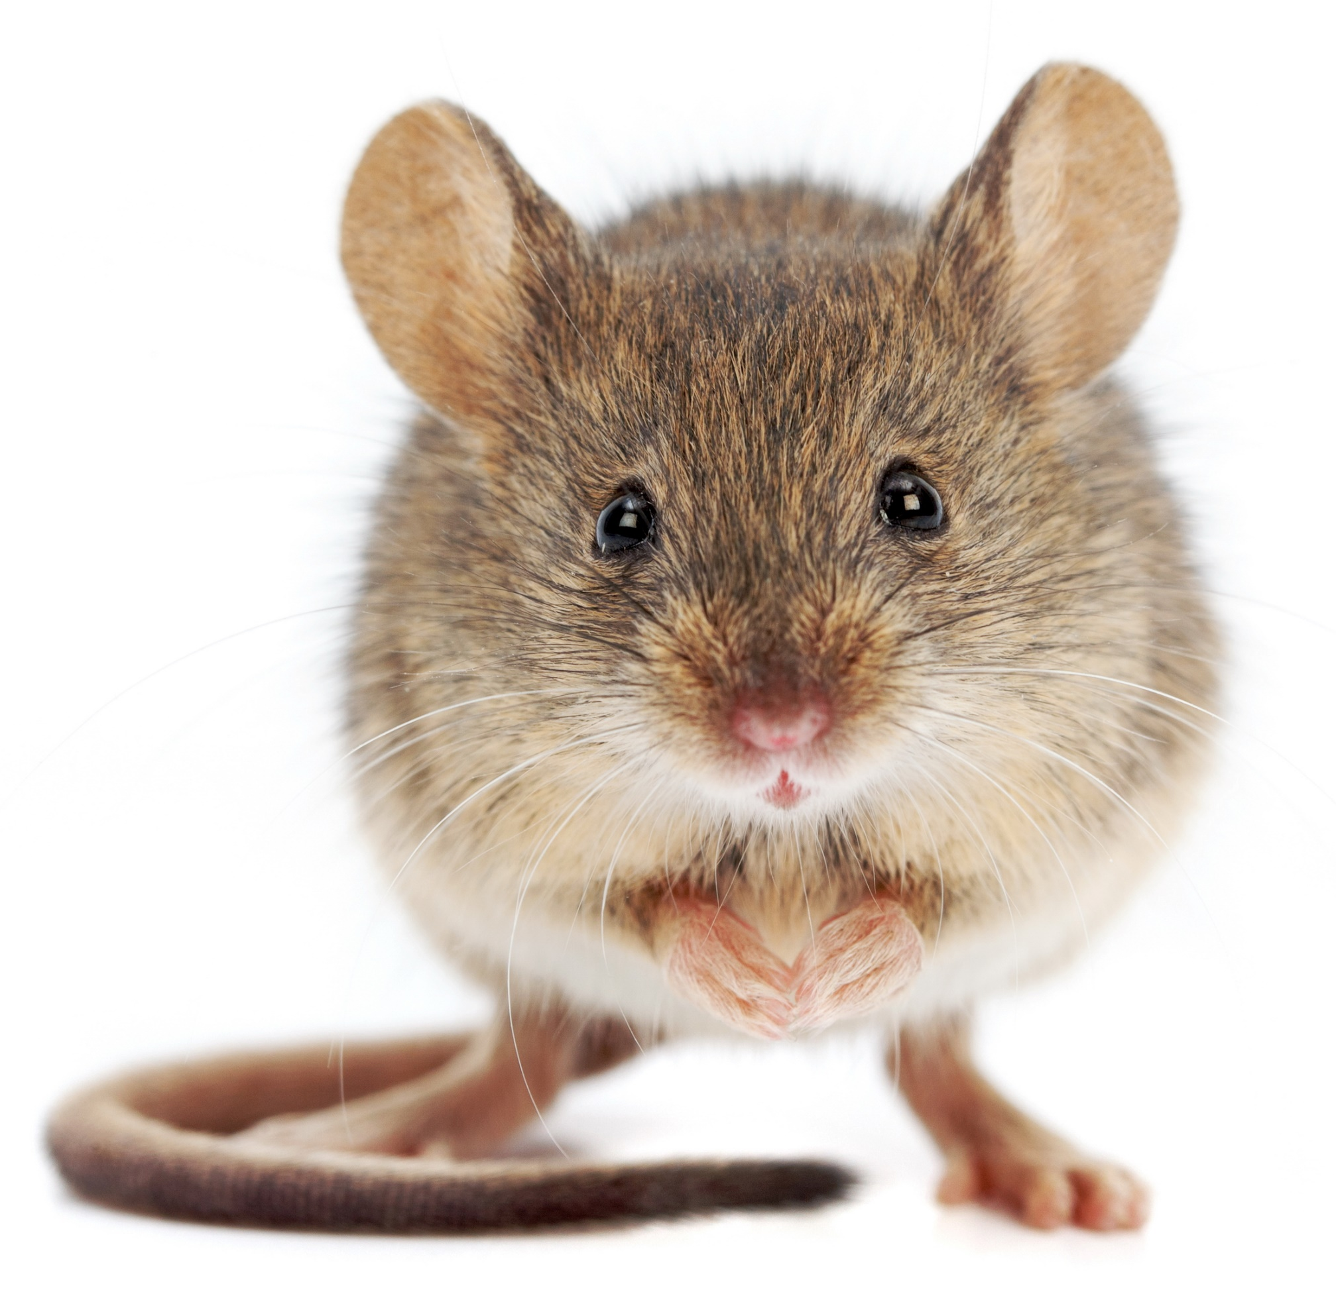
POTPOURRI $100
D. Mouse
This line comes from Clement Clarke Moore’s poem A Visit From Saint Nicholas. It was originally published on December 23, 1823.
6
Pick one.
Notes:
Source: https://www.huffpost.com/entry/twas-the-night-before-christmas_n_801194
Photo by icefront on Envato Elements: https://elements.envato.com/house-mouse-standing-mus-musculus-P8Y5DEM

